Slide 1


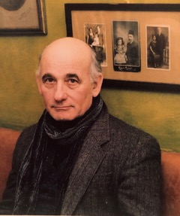
https://hhrecny.org/
Joseph Gosler
Holocaust Survivor
Joseph Gosler was born in the Netherlands in July 1942. At seven
months old, he was given to the Dutch resistance and placed with the
Dijkstra family. Though danger lurked everywhere he was lucky, his birth parents (Henriette and Maurice) were not as fortunate. They were caught and severally beaten. His mother, who had ivory white skin and blue eyes was told that she would be killed if found with a Jew again. His father was taken to a transition camp called Westerbork. The war ended and both parents reunited with their son, but to Joseph they were strangers. He was angry, disoriented and wanted to return to his wartime family. In 1949, (with the addition of his sister, Marja) they immigrated to Israel and subsequently to the USA in 1953.
Joseph is the author of Searching for Home: The Impact of WWII on a Hidden Child (Jewish Children in the Holocaust), his international debut.
[location]
[date]
[time]
Event held at:

