Slide 1


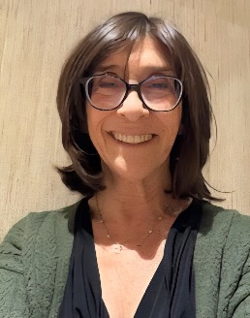
https://hhrecny.org/
Grace Kalfus,
GenerationsForward Speaker
Grace Kalfus is the daughter of Holocaust Survivors,
Frieda Kalfus (née Dulberg) and Chaim (Harry) Kalfus.
Grace tells the story of her mother who was born in Jablonow, Poland in 1923, and whose life changed in 1939 when Hitler signed a non-aggression pact giving Frieda’s town to Russia, and dramatically altered in 1941 when the Nazis invaded this area and the Russians ran East. She came to America and married Grace’s father, who was born in Tarnow, Poland; together they created their own family.
Grace presents her mother’s story to honor her memory and to share Frieda’s kindness, courage, and strength which have guided her own family and serve as a lesson to us all.
Event held at:
[location]
[date]
[time]

