Slide 1


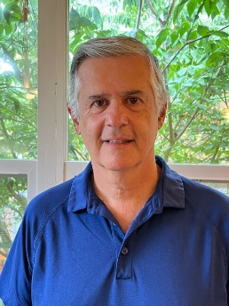
https://hhrecny.org/
Ruben Wind,
GenerationsForward Speaker
Ruben Wind is the son of Holocaust Survivors. Back
in 1938, during Kristallnacht, “Night of Broken Glass,” two
Gestapo officers forced Ruben’s mother's family out of
their apartment in Ingolstadt, Germany. It was the beginning of a long and difficult journey that eventually led them to safety in Buenos Aires, Argentina.
Ruben shares the story beginning during the Holocaust and the decades that followed, that also features his father who attended the 1936 Olympic Games in Berlin, and how he met his mother in Buenos Aires and got married.
Event held at:
[location]
[date]
[time]

