Slide 1
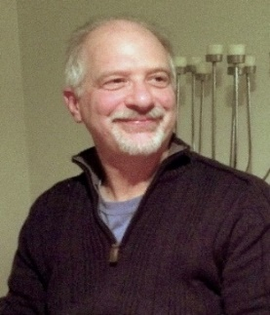
https://hhrecny.org/
Michael Gyory,
GenerationsForward Speaker
Michael Gyory is the son of Hungarian Holocaust survivors. He shares
The remarkable story of his father's first cousin, Agi Keleti. It is a story of
incredible willpower and perseverance of a young woman who not only
survives the Holocaust and outlasts the Communists but eventually goes on to become the greatest female Jewish Olympian champion of all time, winning 10 medals, including 5 gold.
Michael presents Agi Keleti: The Jewish Olympian’s Story of Survival and Triumph accompanied by an exhibit of 6 individual panels that chronicles Agi's incredible life.
Event held at:
[location]
[date]
[time]

