Slide 1
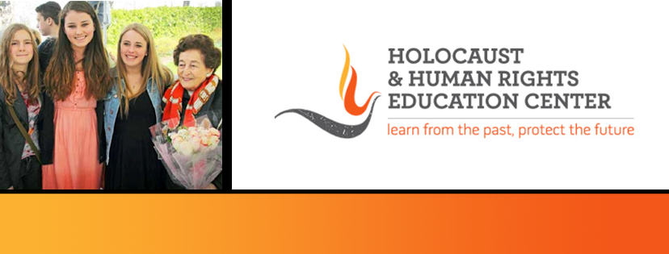
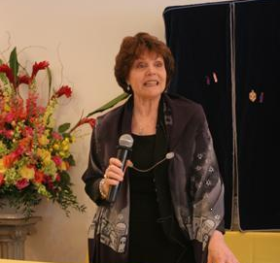
https://hhrecny.org/
Dr. Aliza Levy-Erber,
Holocaust Survivor
Dr. Aliza Levy-Erber was born in the Netherlands in 1943 at the height of the
Nazi occupation and persecution. Her father was sent to the Westerbork
concentration camp in Holland where her mother received permission to visit
him and they married. Shortly thereafter she gave birth to Aliza and the family was deported and separated. The underground hid Aliza in a bunker where she remained for two years.
Dr. Levy-Erber speaks of the surviving family members’ struggle to reunite and survive after the war, of her struggle to overcome her nightmares and demons from growing up in isolation and starvation with a severely traumatized mother, and her need to the find strength and resilience to create a meaningful life. She is the recipient of the 2024 Forbes Torch of Freedom Award; the 2024 Julian Y. Bernstein Distinguished Service Award; the New York City College of Technology Distinguished Achievement Award.
[location]
[date]
[time]
Event held at:

