Slide 1
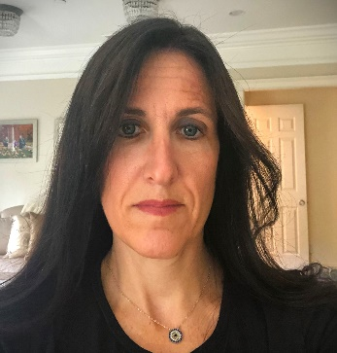
https://hhrecny.org/
Mindy Nagorsky-Israel,
GenerationsForward Speaker
Mindy Nagorsky-Israel is married to the son and grandson
of Holocaust survivors. She tells the story of Ilse Sundheimer
Seelig, her husband’s grandmother, and her family, using
pictures, historical documents and artifacts that have been found.
Ilse grew up in Munich, Germany, a member of multiple prominent Jewish families that had lived in various parts of Bavaria for hundreds of years. Ilse escaped Nazi Germany in late 1938, but she lost her entire immediate family and most of her extended family in the Holocaust. She tells the story of 102 year old Ilse Sundheimer Seelig, her husband’s grandmother, and her family, using pictures, historical documents and artifacts.
Event held at:
[location]
[date]
[time]

