Slide 1
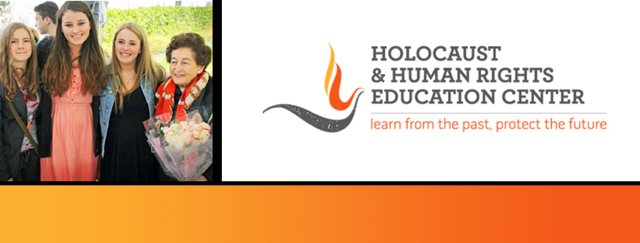
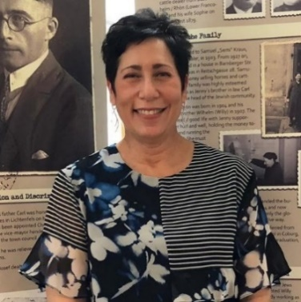
https://hhrecny.org/
Lisa Salko,
HHREC GenerationsForward Speaker
Lisa tells the story of 13 Jewish Drivers' Licenses. In November of 2018, Lisa,
her sisters and cousins traveled to Lichtenfels, Bavaria, Germany to reclaim their
grandfather’s and two great uncles’ drivers’ licenses which had been confiscated
by the Nazis 80 years earlier, shortly after Kristallnacht and rediscovered while the
town was digitizing records in 2017. What started as a trip about reclaiming a part
of their family turned into something so much bigger than them. 13 Jewish Drivers' Licenses is about a small Bavarian town coming to terms with its darkest past. It’s a story about discovery, exploration, and reconciliation. It’s a story about human connection and “doing the right thing”. It’s a story about HOPE. Lisa takes us on an emotional journey during her week long trip which coincided with the 80th Anniversary of Kristallnacht. It’s an important story about being an Upstander and is extremely relevant given the rise of antisemitism in our country, throughout Germany and Europe.
Lisa has presented 13 Jewish Drivers’ Licenses at houses of worship, libraries, educational symposiums, middle and high schools; at colleges and universities; the Museum of Jewish Heritage, the German Consulate in New York, and at Yad Vashem: The World Holocaust Remembrance Center in Jerusalem, Israel.
[location]
[date]
[time]
Event held at:

