Slide 1
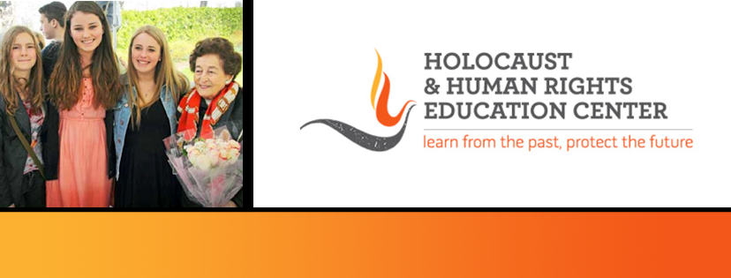
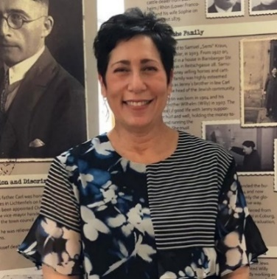
https://hhrecny.org/
Lisa Salko,
HHREC GenerationsForward Speaker
Lisa tells the story of 13 Jewish Drivers' Licenses. In November of 2018,
Lisa, her sisters and cousins traveled to Lichtenfels, Bavaria, Germany to reclaim
their grandfather’s and two great uncles’ drivers’ licenses which had been
confiscated by the Nazis 80 years earlier, shortly after Kristallnacht and
rediscovered while the town was digitizing records in 2017. What started as a
trip about reclaiming a part of their family turned into something so much bigger than them.
13 Jewish Drivers' Licenses is about a small Bavarian town coming to terms with its darkest past. It’s a story about discovery, exploration, reflection and reconciliation. It’s a story about human connection and “doing the right thing”. It’s a story about HOPE. Lisa takes us on an emotional journey during her week-long trip which coincided with the 80th Anniversary of Kristallnacht. It’s an important story and extremely relevant given the rise of antisemitic occurrences in our country today, throughout Germany and Europe. She has presented 13 Drivers’ Licenses at synagogues, libraries, educational symposiums, middle and high schools; at Manhattanville University, Baruch College/CUNY, the Museum of Jewish Heritage, the German Consulate in New York, the Church of St. Ignatius Loyola in NYC, and Yad Vashem: The World Holocaust Remembrance Center in Jerusalem, Israel. She also appeared as the keynote speaker at the 2024 HHREC High School Human Rights Institute at Iona University.
[location]
[date]
[time]
Event held at:

