Slide 1
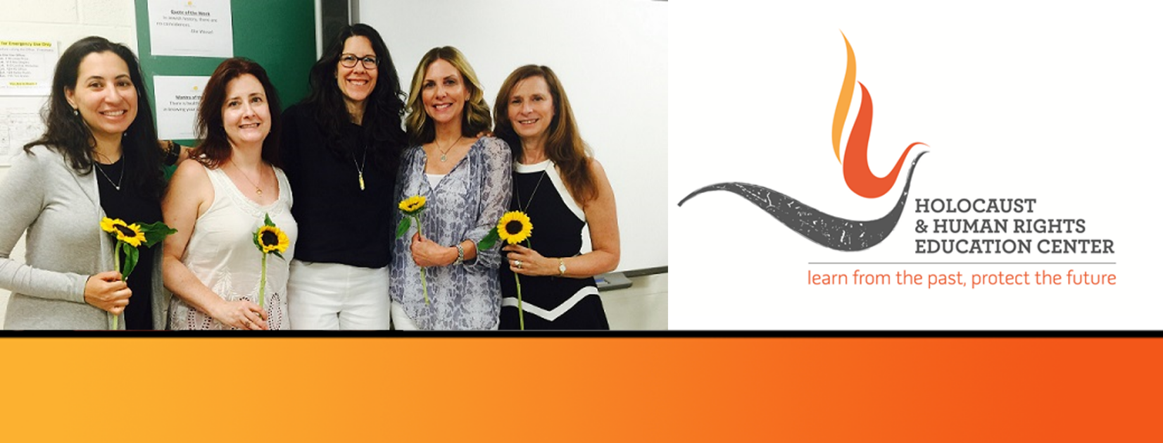
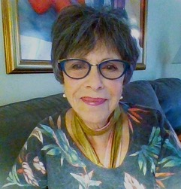
https://hhrecny.org/
Joan Arnay Halperin
GenerationsForward
In 2012, while doing research for her book My Sister’s Eyes: a Family Chronicle of Rescue and Loss During World War II, Joan learned of her family’s debt to the Holocaust rescuer Aristides de Sousa Mendes the Portuguese Consul General in Bordeaux, France.
In recent years Joan dedicates her energies to sharing the story of her family’s 1241-day journey on the road to freedom with teachers and students at the elementary through university level.
Joan will share excerpts from the testimony her mother Helene Arnay gave on January 1, 1989.
[location]
[date]
[time]
Event held at:

