Slide 1
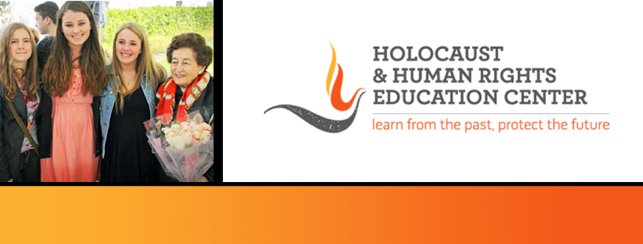
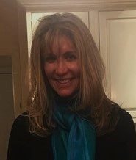
https://hhrecny.org/
Gila Ellen Fortinsky,
GenerationsForward
Gila is the daughter and granddaughter of Holocaust survivors. Her mother and
grandparents were forced into the Kovno Ghetto in Lithuania in 1941, where they lived in
squalor, fear and starvation for three years. Her mother, as a toddler, was hidden during the
KinderAktion, when the Nazis kidnapped every child they could find in the ghetto, and from
then lived in hiding under a plank in the ghetto room the family shared.
Gila has researched her family experience extensively, visiting sites and addresses in Lithuania and recounts the harrowing ordeal and shear determination that propelled her family to survive the brutal years under Nazi occupation, and to emerge, with help of the partisans and the Jewish underground, and begin a new life, first in Europe and finally in Montreal, Canada. She has uncovered video interviews, deposition and trial transcripts describing her family’s ordeal and what it took to be the only intact family to survive the liquidation of the Kovno Ghetto by the Nazis. Her grandfather was a prominent Zionist leader in Lithuania before the war and testified in Nazi war criminal trials in later years, writing a book on Lithuanian Jews and working as the Montreal correspondent for the Algemeiner Journal. Gila is hard at work writing her own book on her family’s Holocaust past.
[location]
[date]
[time]
Event held at:

