Slide 1
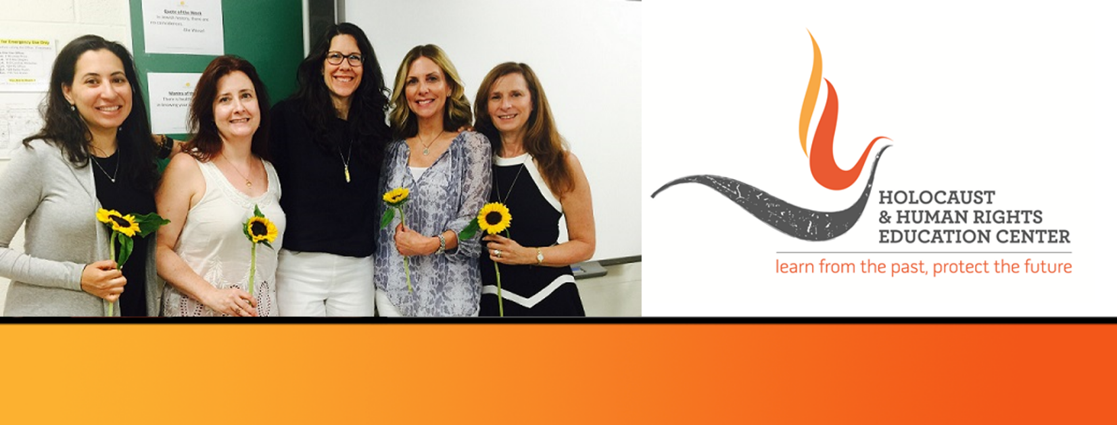
https://hhrecny.org/
Ziporah Janowski,
GenerationsForward Speaker
The daughter of two Holocaust survivors, Ziporah’s mother Chana Mosler was barely 16
when she was deported to a work camp from her small town of Olkusz, Poland.
Ziporah’s father, Meier Janowski, was living a prosperous life in the Polish town of
Wolbrom where he was helping run the family business and was part of a revered
religious family. The Nazis entered the town at the beginning of the war and quickly
deported or killed the Jewish residents.
Quoting newly discovered documents written by her father, Ziporah tells in her father’s own words the shocking detail of his and his family’s deportation. She describes the torture her father endured throughout his journey through multiple labor camps and his imprisonment in the Buchenwald concentration camp, culminating in his being part of an infamous death march to Thierenstadt.
Ziporah speaks of her father’s incredible losses framed by his cleverness and innate will to survive and of how he picked up the pieces of his shattered life to create a new family, moving from Germany to Israel and then the United States. Ziporah also speaks of what life was like as the American child of Polish Holocaust survivors and the lasting imprint being Holocaust survivors left upon her parents. Her presentation is at its heart a love letter to her father and a reminder to all that their family stories are precious and merit knowing and telling.
Event held at:
[location]
[date]
[time]

