Slide 1
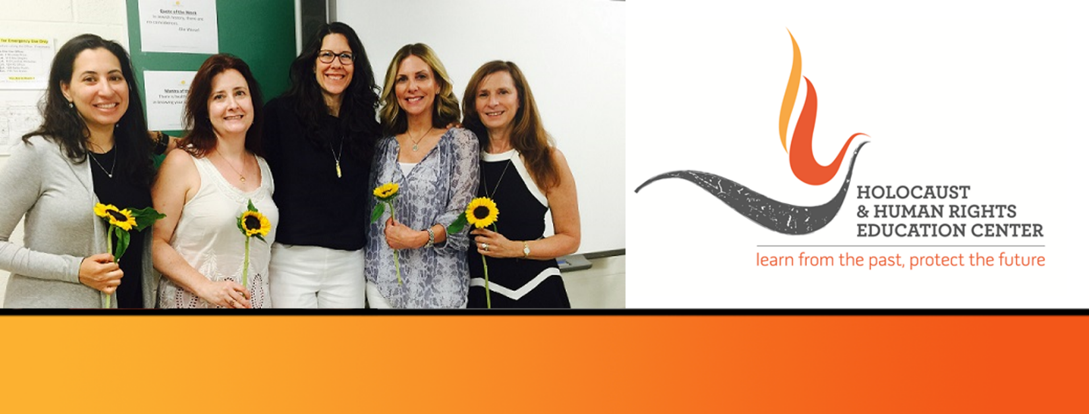
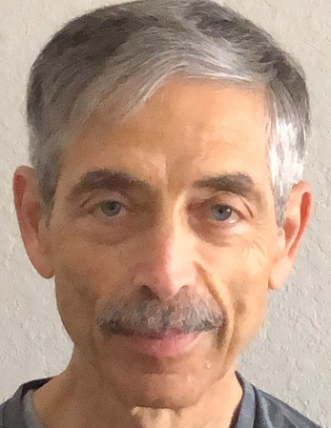
https://hhrecny.org/
William Zimmerman,
GenerationsForward Speaker
William is the son of Holocaust survivors Frieda and
Morris Zimmerman, Polish Jews from small towns who
survived work camps, ghettos and concentration camps
during the Holocaust.
William tells the story of their amazing journey and his own, as he joined his parents on a pilgrimage back to Poland with his wife, three sons and two daughters-in-law, and returned last summer on an HHREC-sponsored trip to Germany and Poland. He also shared his experiences including his visit to the Buchenwald concentration camp 77 years after his father’s liberation from the camp. William has been an educator for 50 years. Following 36 years in the K-12 domain, he has continued his career at Iona University where he has supervised Education majors in PreK-12 fieldwork placements. He has also taught math courses and a Holocaust studies course. He works as a Gallery Educator at the Museum of Jewish Heritage in Manhattan where he conducts student-oriented tours of the exhibit “The Holocaust: What Hate Can Do.”
[location]
[date]
[time]
Event held at:

