Slide 1
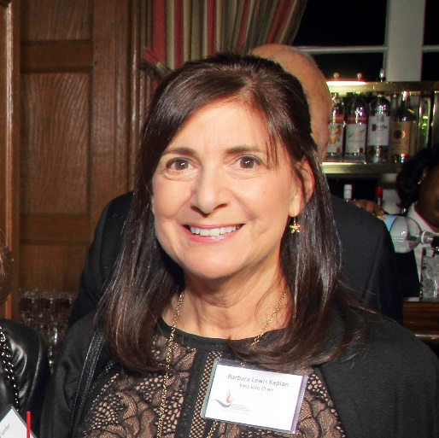
https://hhrecny.org/
Barbara Lewis Kaplan
GenerationsForward
Barbara Lewis Kaplan is the
daughter of a Holocaust survivor. She tells the story
of her father, Leon Lewis, who grew up in Krakow, Poland
and survived the horrors of the Holocaust, enduring slave
labor and torture at four different concentration camps,
including Plazcow, the camp portrayed in the film, “Schindler’s List.” Barbara also recounts her father’s literal leap of faith jump to escape a cattle car headed to an extermination camp. Her father’s story is also one of resilience and perseverance as his daughter talks about his building a new life in America, while overcoming more obstacles including the death of his American-born wife at a young age. With rare photos and video, Barbara brings to life her father’s incredible journey, and describes her emotional trip back to Krakow with Leon. Barbara lives in Larchmont, NY.
[location]
[date]
[time]
Event held at:

