Slide 1
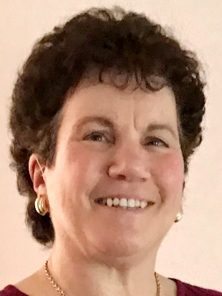
https://hhrecny.org/
Helen Rubel,
GenerationsForward
Helen Rubel is the daughter and granddaughter of Holocaust survivors. Helen tells
the story of her mother and maternal grandmother, who had lived in harmony with
their neighbors in Hadamar, a small town in Western Germany. After Kristallnacht,
the night of broken glass, when the Nazis destroyed Jewish homes, businesses and
synagogues, their entire lives changed. Helen shares her mother’s first-person
account of that night and how she and Helen’s grandmother escaped to Holland,
where they were hidden in an attic in Amsterdam until the Nazis were defeated.
An important theme of Helen’s story is the value of being an “upstander,” someone who stands up for what is right. This concept is illustrated by the courage of the Dutch family who hid her mother and grandmother. She also explores the themes of never giving up, being resourceful, taking risks, and just plan luck, that contributed to her family’s survival.
Helen has spoken to groups about her family’s experiences, as well as the impact of growing up as a child of survivors and first-generation American. She has made several visits to her parents’ hometowns in Germany and participated in remembrance programs there. Helen lives in Irvington, NY, with her husband, a retired attorney. Her son and daughter live in Rockville, MD, and Stamford, CT, respectively, and are both special education teachers. She is a Licensed Clinical Social Worker, who has worked with diverse populations, from preschool children with special needs to elderly, homebound seniors.
Helen is a member of GenerationsForward, a group of second and third generation individuals sponsored by the Holocaust and Human Rights Education Center of White Plains, NY.
[location]
[date]
[time]
Event held at:

