Slide 1
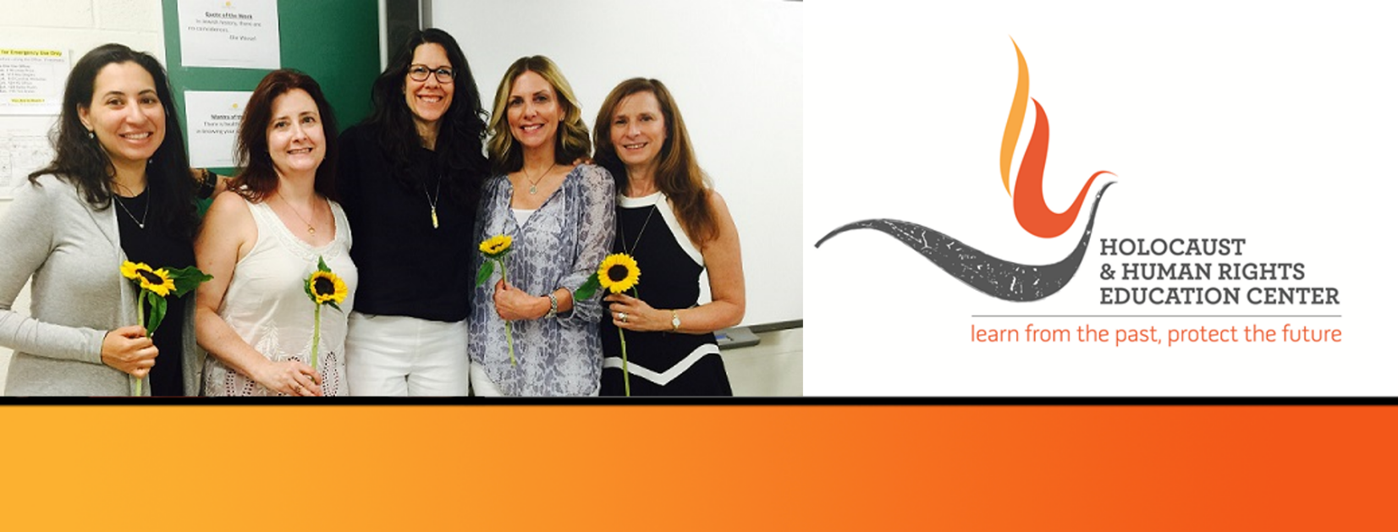
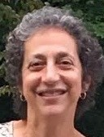
https://hhrecny.org/
Ann Rolett,
GenerationsForward
Ann Rolett’s mother Ingrid Sacks was never comfortable speaking in
public about her experience as one of the 1500 Jews who survived hiding
in plain sight in Berlin, Germany during the Holocaust. Ann wrote her
mother’s story with her mother’s help so that her experiences not be
forgotten. She researched the extended family her mother vaguely remembers and intertwines her family’s history with the rising success and precipitous fall and destruction of the Jews of Berlin and Germany.
Berlin before Hitler was very much like the US today, a place where Jews were well integrated into the fabric of society and viewed themselves as loyal and respected citizens. Ann tells this story because she believes its lessons about how the Nazi’s used propaganda and laws to isolate and destroy this community are relevant and important in the US today. The story is told from her mother’s perspective, a child’s perspective, so is appropriate for audiences’ of all ages. Ann accompanies the story with family photos saved by relatives who escaped Germany. Ann and her husband Rod retired young because they love active travel. In 2018, they spent 3 months bicycling in Norway and the west coast of Sweden. Prior trips included extensive hiking and biking in Australia and New Zealand. When they are home, they are active in their communities.
[location]
[date]
[time]
Event held at:

