Slide 1
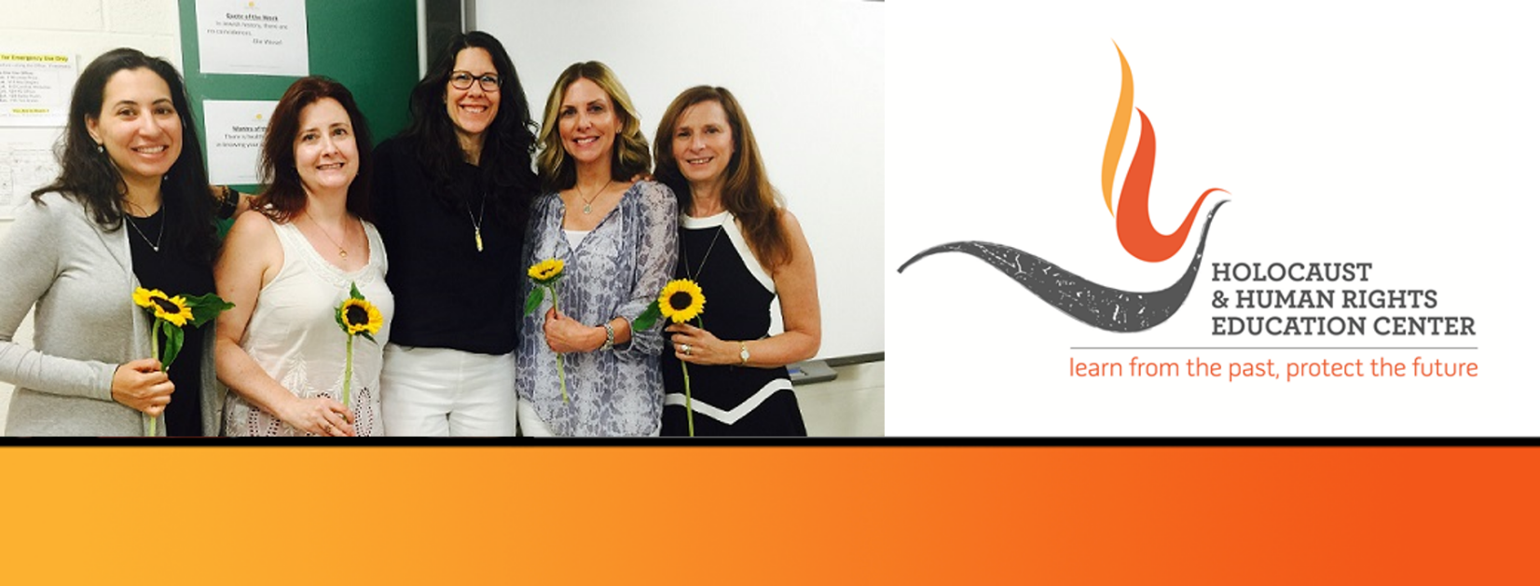
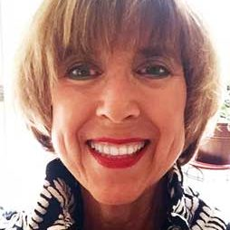
https://hhrecny.org/
Sandra Mehl,
GenerationsForward
Sandra Mehl is a first generation American who lost several
family members in the Holocaust. She tells the story of the heroic
deeds of the Horner and Kellner families, who lived in Poland,
Germany and Belgium, and rescued lives and precious legacy from
Nazi occupied Europe. Additionally, she shares the impact of her
experiences growing up with survivors and offers a message of
hope for the next generations – how to shift from surviving to
thriving.
Although Sandra’s story evolved from a commitment to keeping her family’s values and traditions alive and a desire to gift a unique legacy to her grandson, Zevi on the occasion of his becoming a Bar Mitzvah, she is also determined to help the next generations connect to a fateful time in history that dares to repeat itself, and accept the call to action to make certain “never again”.
Sandra graduated from Columbia University and is a Licensed Master of Social Work and practitioner of energy medicine. After living in Harrison, Westchester where she raised her children, practiced in neighborhood hospitals, taught Hebrew and Global Studies in community schools, she recently moved to Stamford, Ct. where she happily lives near her family, and is excited to start the next chapter.
[location]
[date]
[time]
Event held at:

