Slide 1
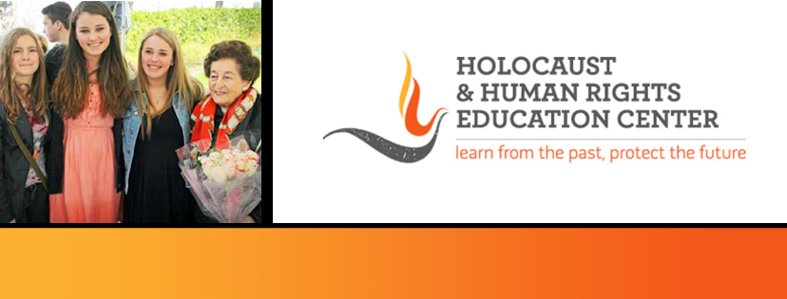
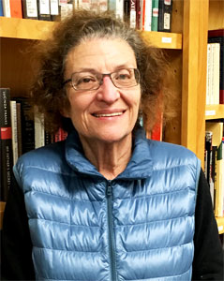
https://hhrecny.org/
Jose Coltof,
Holocaust Survivor
Jose lived with her father and mother in
Amsterdam. Her mother and she went into
hiding; her father was murdered at Auschwitz.
At 4 months old, her mother gave her to
strangers for safekeeping where she was raised
by a devout Protestant family who loved her dearly. At age 3, her mother returned from hiding and retrieved her. Jose always loved her foster family and stayed in touch with them until they died at an elderly age. Her message to the students is that the people who raised her, at great risk to themselves, were true heroes and she challenges students to think about other people who could be considered heroes.
[location]
[date]
[time]
Event held at:

