Slide 1
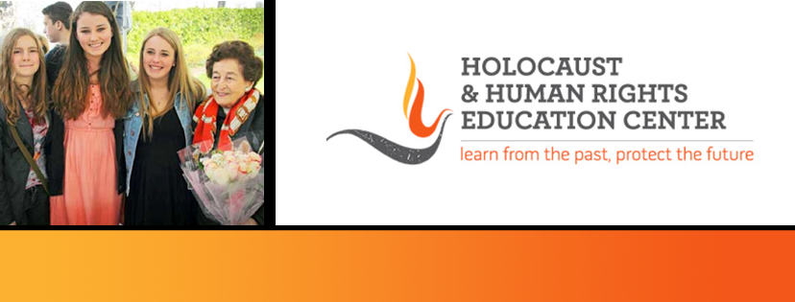
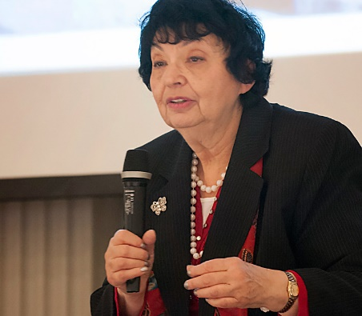
https://hhrecny.org/
Inge Auerbacher,
Holocaust Survivor
Inge Auerbacher was the last Jewish child born in
Kippenheim, a village in South-Western Germany located at
the foot of the Black Forest, close to the borders of France
and Switzerland. She was the only child of Berthold and
Regina Auerbacher (nee’ Lauchheimer.) Both of her parents
came from observant Jewish families who had lived for many generations in Germany.
Inge has been lecturing on the Holocaust since 1981, and has spoken to thousands of people in the USA, Canada and Germany. She is fluent in German and English. Her audiences consist of school children, college students and adults of any ethnic background. She has appeared on many radio and television programs both in the USA and abroad. Prize-winning documentary films have been made about her, which have been shown in the USA and all over the world.
Her most recent film: "The Olympic Doll" based on her book "I Am A Star" was especially made for middle school children as a lesson of tolerance.
[location]
[date]
[time]
Event held at:

