Slide 1
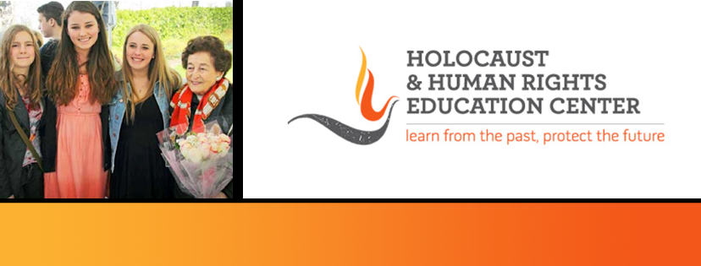
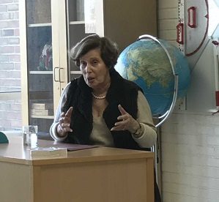
https://hhrecny.org/
Betty Knoop,
Holocaust Survivor
Betty Knoop was born in Amsterdam, The
Netherlands. She was 8 years old when the
Germans invaded her country. Her whole family
was arrested and sent to transit camp
Westerbork and on to Bergen Belsen concentration
camp. She was liberated by the Russians and returned to Amsterdam. Her mother survived the camp but died 3 days after she was liberated. Betty was a contemporary of Anne Frank, lived in the same neighborhood and was deported to the same concentration camp.
Betty Knoop's presentation covers life in Amsterdam, Westerbork, Bergen Belsen, and life after liberation.
[location]
[date]
[time]
Event held at:

