Slide 1
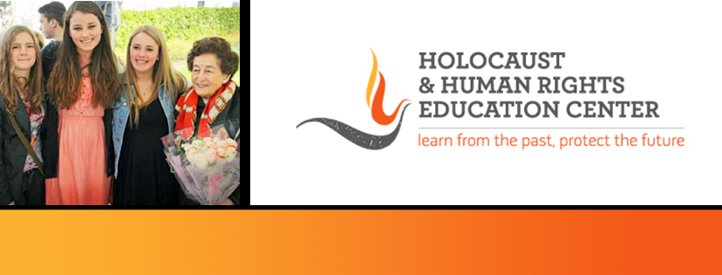
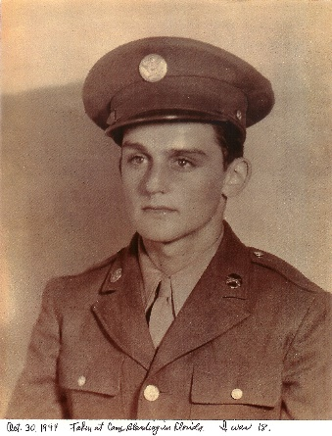
https://hhrecny.org/
Alan Moskin,
Holocaust Liberator
Alan Moskin was born in Englewood, New Jersey on May 30, 1926. Alan was
drafted into the military service at the age of 18 and served in the United States
Army during World War II from September 1944 until August 1946. He was a
member of the 66th infantry, 71st Division, part of General George Patton's 3rd
Army. Alan's outfit fought in combat through France, Germany and Austria during
which time he was promoted in rank from Private to Staff Sergeant.
At the beginning of May 1945, his Company participated in the liberation of the
Gunskirchen Concentration Camp, a sub-camp of Mauthausen. After the war ended, Alan remained in Europe until June 1946 as a member of the U.S. Army of Occupation.
Alan presently resides in Nanuet, New York and he has spoken to Middle School and High School students as well as other groups in a number of different states and venues throughout the country about his experiences as an infantry combat soldier and a "Concentration Camp" liberator.
He attended Syracuse University both before and after his military service in World War II and graduated in May 1948. He then attended New York University Law School, graduating with a J.D. degree in June 1951. He practiced law as a civil trial attorney in New Jersey for over 20 years and subsequently worked in the private business sector until he retired in 1991.
Alan has two grown daughters and seven grandchildren. He presently serves as a Vice President on the Board of Trustees of the Holocaust Museum and Center for Tolerance and Education and is also a Past commander of the Rockland / Orange District Council of the Jewish War Veterans of the U.S.A. In addition, in 2014 Alan was inducted into the New York State Senate Veterans Hall of Fame and the following year he was elected by the Veterans Coordinating Council in Rockland County, N.Y. to be the "2016 Veteran of the Year."
[location]
[date]
[time]
Event held at:

